Slide 1
A Neutral Algorithm of Artistic Style
汪思学 2016/4/27

Slide 2
Outline
Previous Work
Main Idea

Slide 3
Previous Work

Slide 4
NPR
非真实绘制（渲染）
Non-photorealistic rendering

Slide 5
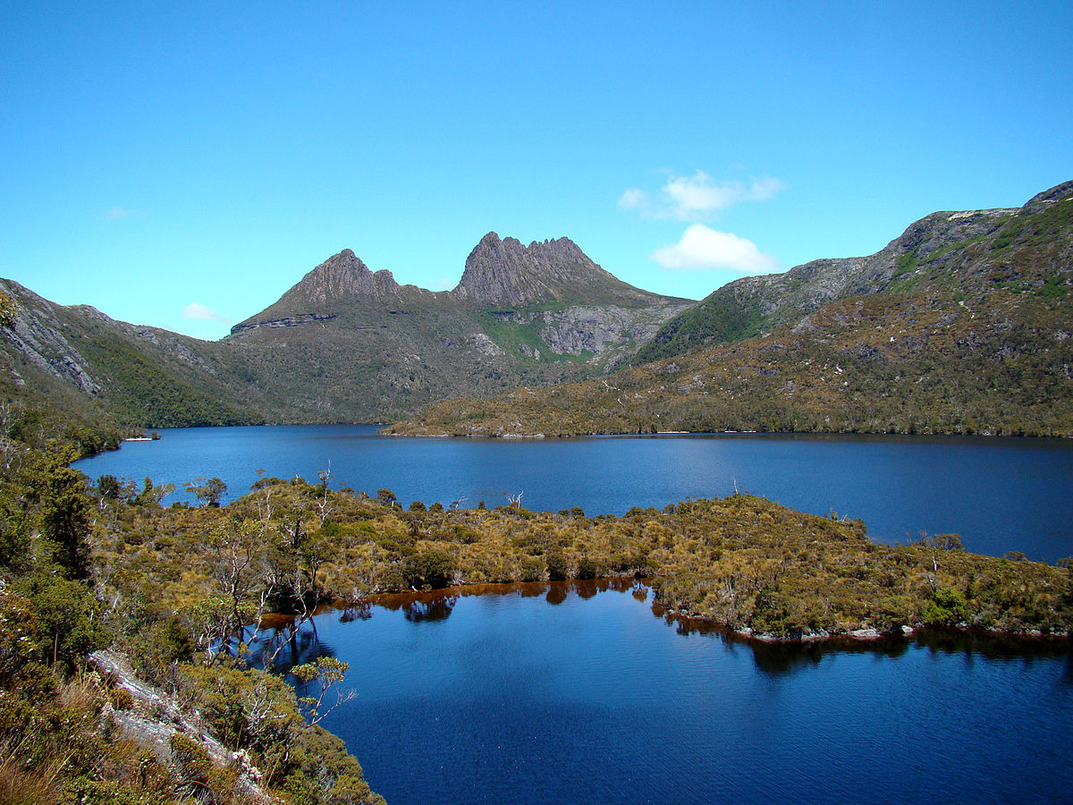
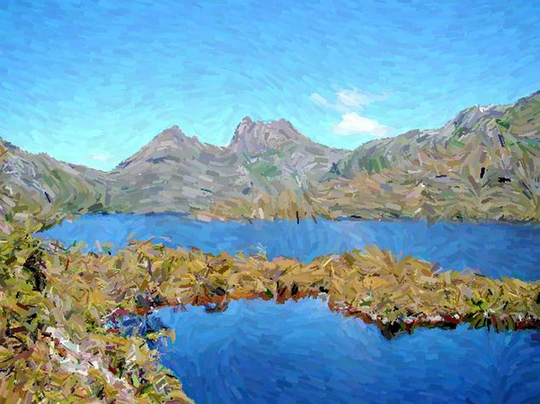
Cradle Mountain Behind Dove Lake
source from wiki

Slide 6
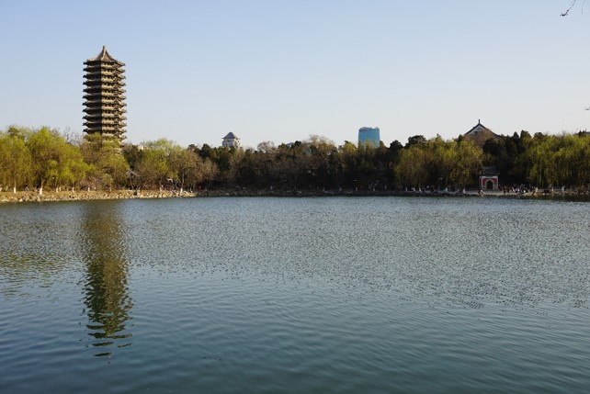
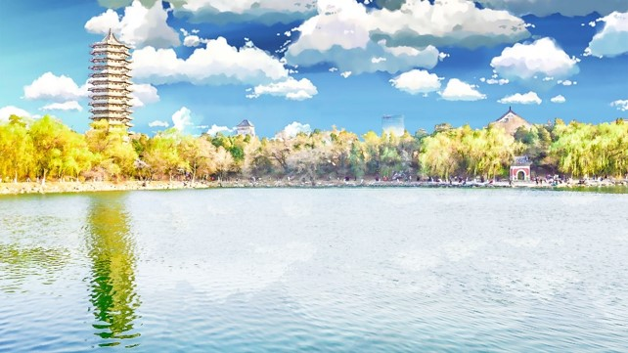
图像风格化？Photoshop的滤镜？
Source from : 何川&马薇薇

Slide 7
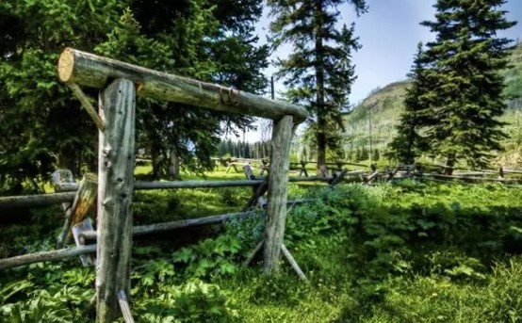
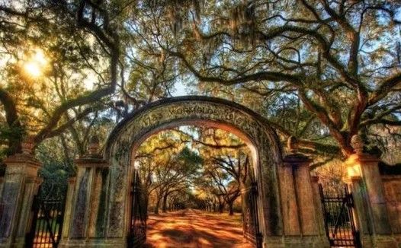
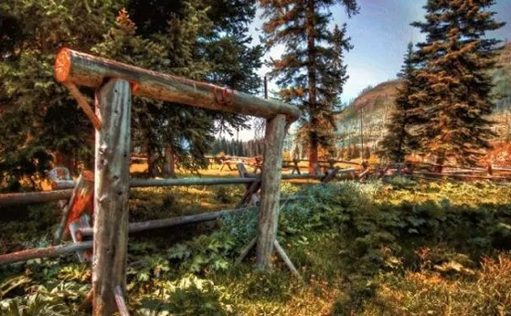
Optimization transmission method

Slide 8
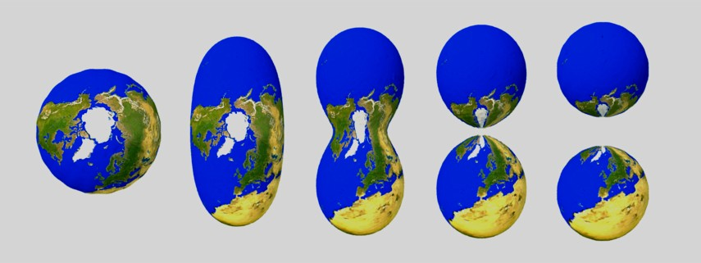
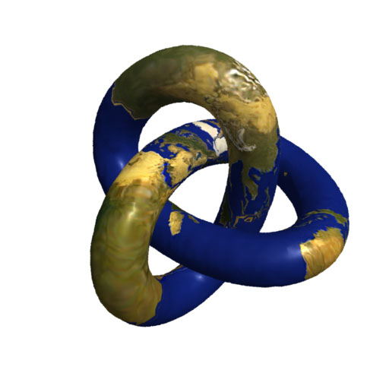
Texture Transfer

Slide 9
What is a Texture？
The natural world is rich in texture: the surface of any visible object is textured at certain scale. A wealth of textures are observed on both artificial and natural objects such as those on wood, plants, materials and skin. In a general sense, the word texture refers to surface characteristics and appearance of an object given by the size, shape, density, arrangement, proportion of its elementary parts. A texture is usually described as smooth or rough, soft or hard, coarse of fine, matt or glossy, and etc.
Source from https://www.cs.auckland.ac.nz/~georgy/research/texture/thesis-html/node5.html

Slide 10
Main Idea
提取内容
提取风格（Texture）
图片合成

Slide 11
内容提取
直接基于现有的物体识别的CNN（VGG）
高层的卷积层限制了像素的整体分布

Slide 12
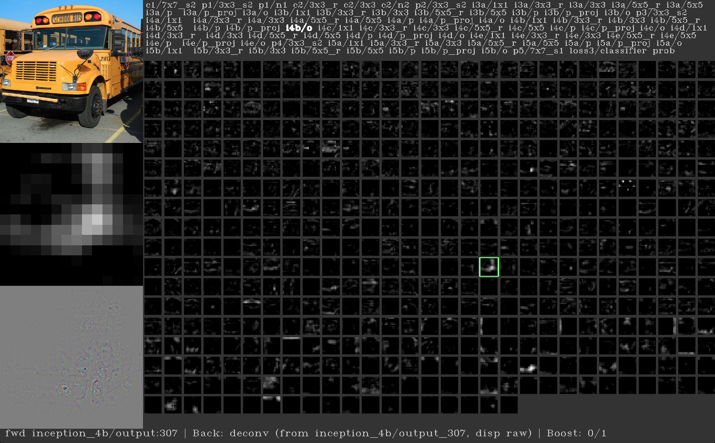
source from ：https://github.com/yosinski/deep-visualization-toolbox

Slide 13
风格提取
使用特征空间来描述纹理信息
底层的卷积层限制了像素的取值
色彩与局部结构

Slide 14
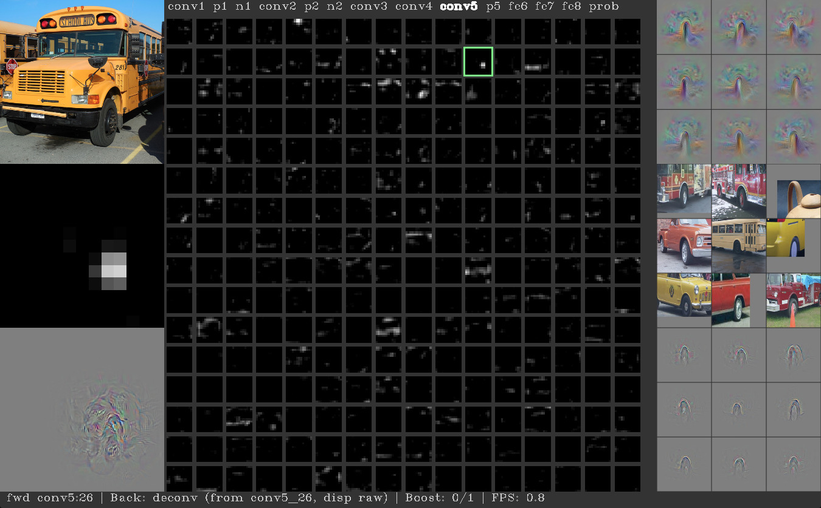
source from ：https://github.com/yosinski/deep-visualization-toolbox

Slide 15
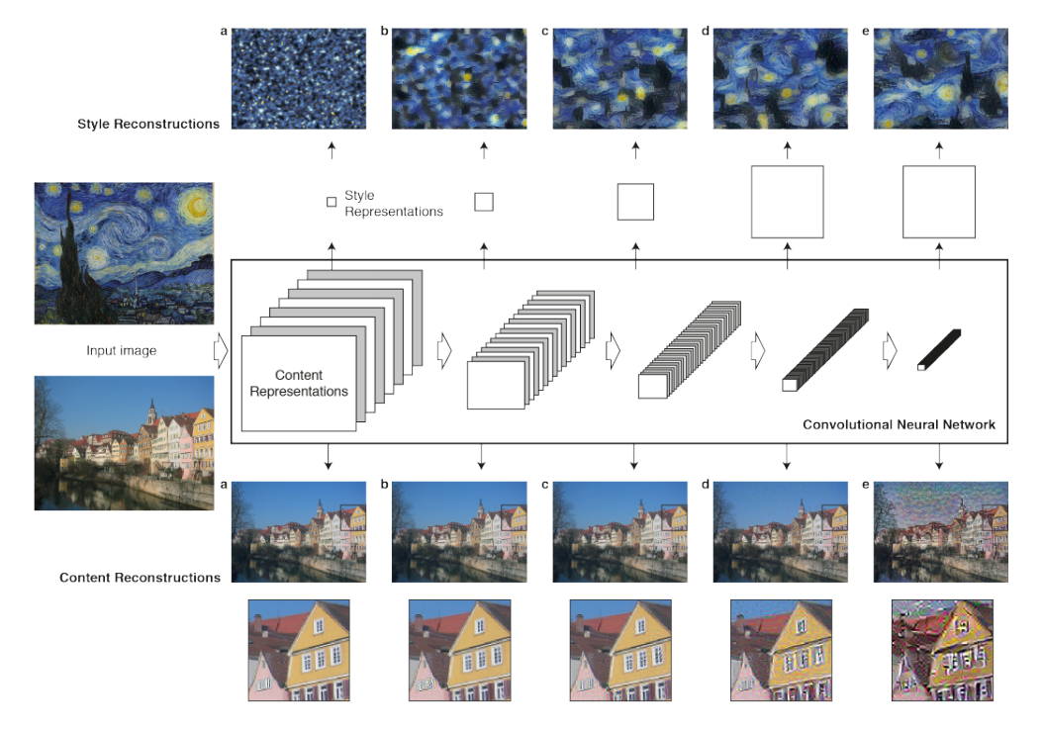

Slide 16
图片合成
类似CNN训练的过程，对白噪声图利用loss function 进行BP

Slide 17
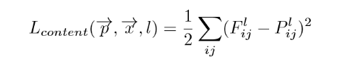
Content Loss

Slide 18
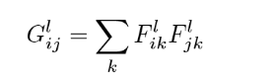
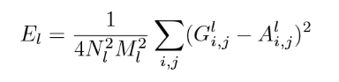
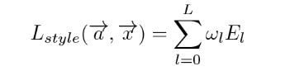
Style loss function
Gram Matrix:
Layer loss:
Total Style loss:

Slide 19
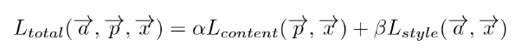
Total Loss

Slide 20
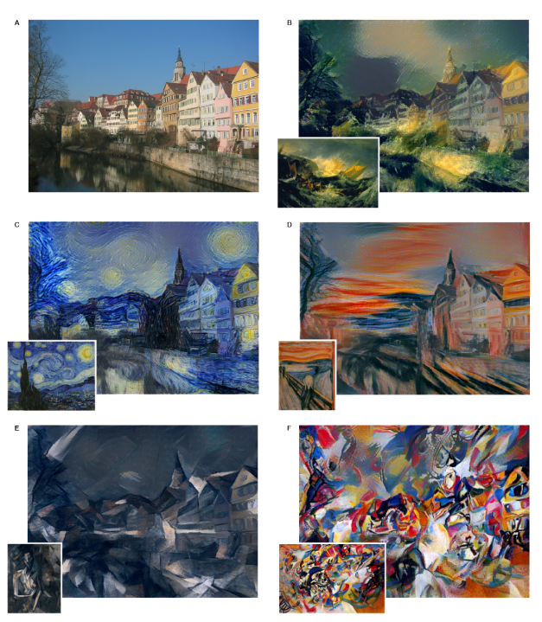
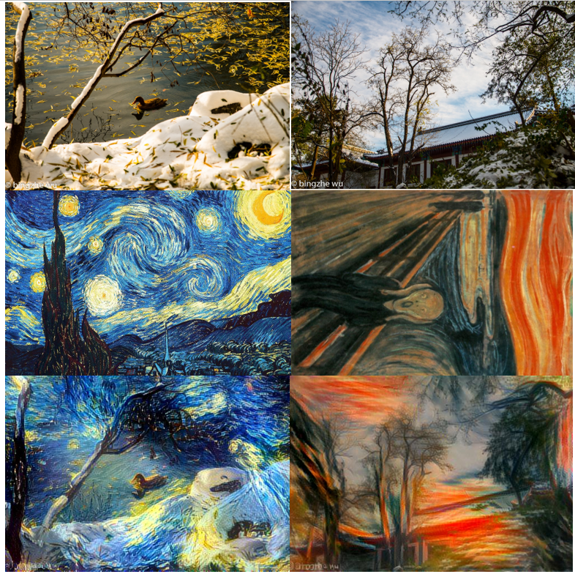
Result
B：the shipwreck of the Minotaur. C:The Starry Night. D:Der Schrei. E:Femme nue assise. F:Composition VII

Slide 21
Thanks

